Slide 1
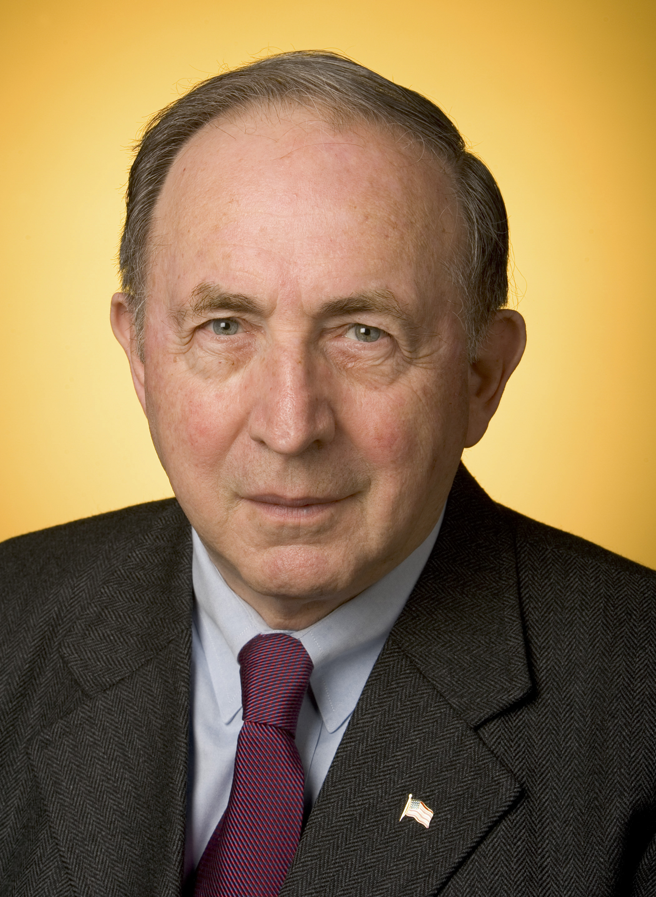
Wealth and Income Inequality
Paul A. Strassmann, December 9, 2017

Slide 2
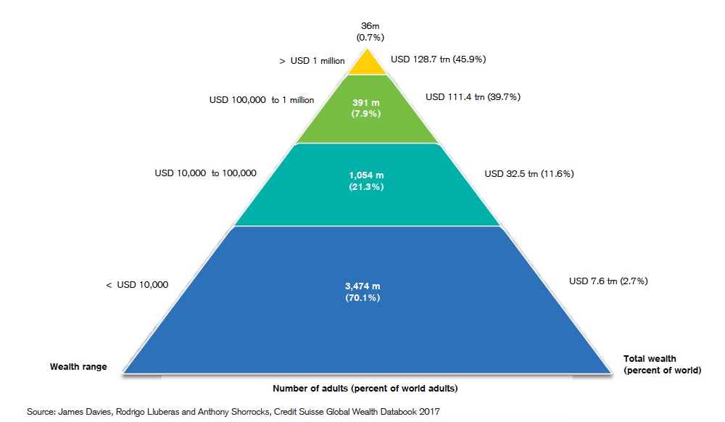
Global Wealth Pyramid

Slide 3
2017 Distribution of Global Wealth
0.7% of global adults own 45.9% of global wealth.
0.7% of adults have wealth >$1 million.
70.1% of global adults own <2.7% of global wealth.
70.1 % of adults have wealth of <$10,000.

Slide 4
2017 Inequality in Distribution of Global Wealth
36 million global adults own >$129 trillion of global wealth.
3,472 million global adults own <$8 trillion of global wealth.

Slide 5
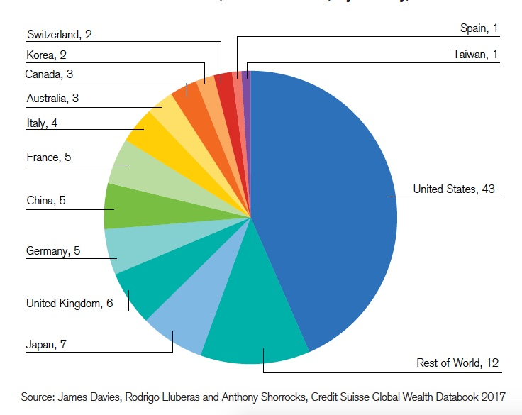
Share of Millionaires by Country

Slide 6
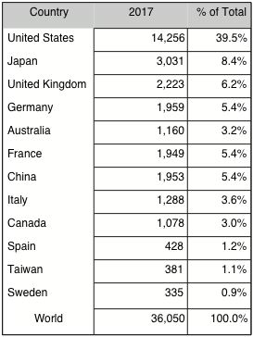
2017 Share of Millionaires

Slide 7
2017 Number of Millionaires
Twelve countries have 83% of all millionaires.
Emerging country (China) has only 5.4% of millionaires

Slide 8
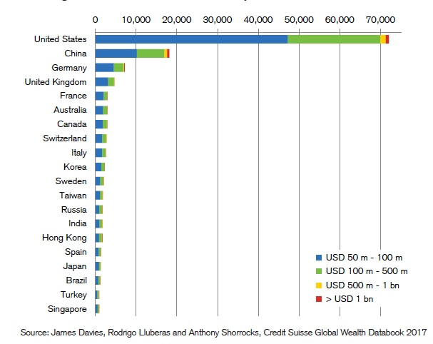
Ultra-High Net Worth Individuals in 2017
Credit Suisse, Global Wealth Report 2017

Slide 9
Concentration of Extreme Wealth
Only US, China and Germany many billionaires.
Every other country has a few billionaires,

Slide 10
Inequality in US Wealth
1% of US population holds >35.5% of total wealth
2% of US population holds >46.4% of total wealth
5% of US population holds >63% of total wealth
10% of US population holds <75% of total wealth
20% of US population holds <87% of total wealth
25% of US population holds <91% of total wealth

Slide 11
Recent Trends in US Wealth
Adult wealth doubled from 2002 to 2016.
2008 to 2016 average adult wealth increased by >56%.
The 2006 recession lowered adult wealth by >17%.
The rise in average adult wealth hides rising inequality.

Slide 12
About New Canaan
Average New Canaan household has net worth is $1.4 million*.
New Canaan households rank in <0.7% of global wealth.
New Canaan households rank in <2% of US wealth.
Ranking does not reflect high inequality within New Canaan.
* https://www.google.com/search?q=new+canaan+median+income&sa=X&ved=0ahUKEwia88-Tn_7XAhWDMSYKHX_yClMQ1QIIsgEoAg&biw=1131&bih=670

